Slide 1






Enhanced environmental protection inspection for efficient control of air quality monitoring and of all entities under obligation within system of greenhouse gas emission allowance trading, in order to achieve better air quality in Republic of Croatia
This project is funded by the European Union

Slide 2



12. Air quality data
Energy research and Environmental Protection Institute
Bojan Abramović dipl. ing. stroj.
Mato Papić dipl. ing. stroj.

Slide 3

12.1 DATA TYPES
European Union IPA 2013 Programme for Croatia
There are different types of data
Network and Station information (Metadata)
Measurement data
Source data
Validated data
Statistical data
Energy Research and Environmental Protection Institute

Slide 4
12.1 DATA TYPES
European Union IPA 2013 Programme for Croatia
MEASUREMENT DATA
Source data
These are individual hourly "raw" values obtained by automatic continuous air quality measurement (UTD - Up To Date Data (NRT Near Real Time)
Validated data
measured values obtained by automatic continuous measurement of air quality that have passed the validation process
measured values obtained by sampling of 24 hours measurement
Energy Research and Environmental Protection Institute

Slide 5
12.1 DATA TYPES
European Union IPA 2013 Programme for Croatia
Types of measurement data (Agency’s Portal of air quality)
Hourly source data
Hourly validated data
Eight -hours sourse data
Eight-hours validated data
Daily source data
Daily validated data
Maximum daily 8-hour average value – source data
Maximum daily 8-hour averages value - validated data
Twelve months average - source data
Twelve-month Average - validated vata
Daily source sata - gravimetry
Daily validated data - gravimetry
Energy Research and Environmental Protection Institute

Slide 6
12.1 DATA TYPES
European Union IPA 2013 Programme for Croatia
Hourly data (source and validated)
One hour concentrations given by lower averaging time (baseline data for all pollutants given by automatic measurement)
Some pollutants (SO₂, NO₂, H₂S) have prescribed hourly limit value (LV) and one-hour concentrations are compared with these limit values. These substances have prescribed LVs of higher averaging time (24-hour (SO2, H₂S) or average annual value (NO₂)) calculated from hourly values
Some pollutants do not have prescribed hourly limits values but one-hour values calculate higher average values (24-hour value or average annual value) then comparing them with the prescribed LV or CV (benzene, CO, ozone, particulate matter PM₁₀ and _{PM2,5}, metals As, Cd, Ni, Pb and BaP in PM₁₀, NH₃, mercaptan, metanal
Energy Research and Environmental Protection Institute

Slide 7
12.1 DATA TYPES
European Union IPA 2013 Programme for Croatia
Eight-hour data (sourse and validated)
The eighth hour average is calculated based on hourly data that is updated every hour. Each osmosis average calculated in this way is attributed to the day it ends, ie. the first period of calculation for any day covers the period from 17:00 on the previous day until 1:00 pm that day; the last calculation period for any day is from 16:00 to 24:00 that day.
Daily maximum 8-hour average value (source and validated)
The highest daily eighth hour average concentration is selected based on eight-hours moving averages (calculated from data obtained from one-hour values) - this value is taken for comparison with LV or CV (CO and O₃)
Energy Research and Environmental Protection Institute

Slide 8
12.1 DATA TYPES
European Union IPA 2013 Programme for Croatia
Daily data (24-hour) (sourse and validated)
Average of 24 hourly values per day or
One value given by sampling (given by old non-referential methods)
Twelve-month average source and validated)
Average for the last twelve months (benzene)
Energy Research and Environmental Protection Institute

Slide 9
12.1 DATA TYPES
European Union IPA 2013 Programme for Croatia
Daily data –gravimetry (sourse and validated)
These data were given by gravimetric method (PM₁₀, PM_{2.5} and the composition in particulate matters). Every day a sample is taken from which the concentrations of the particulate matters are determined. From these samples chemical composition analyzes the composition within the particles
PM₁₀ is determined by:
Metals As, Ni, Cd, Pb
B(a)P and other PAUs
PM2.5 is determined by:
Anions of Cations Cl, NO₃⁻, SO₄²⁻, Na⁺, NH₄⁺, K⁺, Mg²⁺, Ca²⁺
Elemental Carbon and Organic Carbon EC/OC
Energy Research and Environmental Protection Institute

Slide 10
12.1 DATA TYPES
European Union IPA 2013 Programme for Croatia
Network and station information (Metadata)
Network information
information about air quality monitoring networks (name, designation, network type, management authority
responsible person's name, address, fax, e-mail, and weather notice),
Station information
sampling site and measurement range
time and pattern of sampling
used measurement methods and measuring equipment
Energy Research and Environmental Protection Institute

Slide 11
12.1 DATA TYPES
European Union IPA 2013 Programme for Croatia
Air quality monitoring network information (Metadata)
name,
designation,
network type,
management authority
the name of the responsible person,
address,
phone, fax, e-mail,
and weather information
Energy Research and Environmental Protection Institute

Slide 12
12.1 DATA TYPES
European Union IPA 2013 Programme for Croatia
Air quality monitoring network information -example
State network
PODACI O MREŽI ZA PRAĆENJE KVALITETE ZRAKA
Name | Državna mreža za trajno praćenje kvalitete zraka
Designation | RH01
Network type | državna mreža
Management authority | DRŽAVNI HIDROMETEOROLOŠKI ZAVOD, GRIČ 3 , GRAD ZAGREB
Responsible person | Lukša Kraljević
Adress | Grič 3, lbl_grad
Phone | 01/4565685
Fax
e-mail | kraljevic@cirus.dhz.hr
web
Time zone | UTC+01
Valid from | 11.02.2003
Valid to
Energy Research and Environmental Protection Institute

Slide 13
12.1 DATA TYPES
European Union IPA 2013 Programme for Croatia
Air quality monitoring stations information (Metadata)
name,
location,
the name of the professional institution responsible for the station,
management authority
measurement goals,
geographic coordinates,
measured pollutants
meteorological parameters,
area type,
station type relative to the source of the emission,
measuring equipment, sampling features, etc.
Energy Research and Environmental Protection Institute

Slide 14
12.1 DATA TYPES
European Union IPA 2013 Programme for Croatia
Air quality monitoring stations information (Metadata)
Measurement methods and sampling data
measurement type
measurment method
measuring equipment,
proof of equivalence
start time
the frequency of data integration
time and pattern of sampling
etc.
Energy Research and Environmental Protection Institute

Slide 15
12.1 DATA TYPES
European Union IPA 2013 Programme for Croatia
Station for air quality monitoring data
Basic information
Name | OSIJEK-1
Network | Državna mreža za trajno praćenje kvalitete zraka
Zone/agglomeration | Osijek
City | Osijek
Location description | Raskrižje Ulice kneza Trpimira i Europske avenije.
Designation | OSI001
EOI designation | HR0003A
AZO designation | RH0104
Management authority | DRŽAVNI HIDROMETEOROLOŠKI ZAVOD, GRIČ 3 , GRAD ZAGREB
Competent authority | Ministarstvo zaštite okoliša i prirode, Hrvatska agencija za okoliš i prirodu, Europska komisija
Web adress
Measurement goals | Impact assessment on human health and the environment, tracking the trend
Coordinates |  |  | x |  | y
 | WGS84 |  | 45º33´31,65´´ |  | 18º41´55,57´´
 | Decimalni prikaz |  | 45,558792 |  | 18,698769
 | Gauss Kruger koordinate |  | 5.046.280 |  | 6.554.958
Altitude (h) | 109
NUTS
Pollutant | SO₂ - (µg/m3), NO₂ - (µg/m3), NOₓ as NO₂ - (µg/m3), O₃ - ozone (µg/m3), CO (mg/m3), benzen (µg/m3), PM₁₀ (<10µm) (µg/m3)
Meteorological parameters | temperature (℃), wind speed (m / s), wind direction (°), relative humidity (%)
E-reporting | yes
Other information
Aktiv from | 12.01.2004 | Aktivna do:
Classification of stations
Area type | city
Type of station in relation to the source of emissions | traffic
Main sources of emissions
The area for which the station is representative
Local area
Regional area
Town and suburban stations
- population of town / village | 114.616
Traffic stations
- estimated volume of traffic | 0
- distance from curb | 25
- the proportion of heavy motor vehicle traffic | 0
Energy Research and Environmental Protection Institute

Slide 16
12.1 DATA TYPES
European Union IPA 2013 Programme for Croatia
-traffic speed |  | 0
- building facade distance and the building height |  | 100
- street width |  | 0
Information on metering technique by pollutants
Pollutant | Measurement type |  | Measurment method | Measuring equipment
SO₂ - sulphur dioxide (µg/m3) | Automatic analyzer |  | UV fluorescence | Horiba model APSA 360 SO2 analyser Horiba model APNA 360 NOx analyser
NO₂ - nitrogen dioxide (µg/m3) | Automatic analyzer |  | Chemiluminescence
NOₓ as NO₂ - nitrogen dioxide (µg/m3) | Automatic analyzer |  | Chemiluminescence | Horiba model APNA 360 NOx analyser
O₃ - ozone (µg/m3) | Automatic analyzer |  | Ultraviolet (UV) photometry | Teledyne API 400E UV photometric O3 analyser
CO - carbon monoksid (mg/m3) | Automatic analyzer |  | Non-dispersive infrared spectroscopy (NDIR) | Horiba model APMA 360 CO analyser
benzene (µg/m3) | Automatic analyzer |  | Gas chromatography followed by flame ionization detection (GC-FID) | AirmoVOC BTX
PM₁₀ - particulate matter(<10µm) (µg/m3) | Automatic analyzer |  | BETA | Thermo Andersen ESM FH 62 I-R
Energy Research and Environmental Protection Institute

Slide 17
12.2 DATA QUALITY TARGET
European Union IPA 2013 Programme for Croatia
 | sulphur dioxide hydrogen sulfide, nitrogen dioxide and nitrogen oxide , ammonia and carbon monoksid | Benzene, mercaptan | Particulate matter (PM₁₀/PM_{2,5}) i lead | Ozone and ozone associated with NO i NO₂
Measurement at constant measuring sites⁽¹⁾:
Uncertainty | 15% | 25% | 25% | 15%
Minimum data coverage | 90% | 90% | 90% | 90% during the summer 75% during the winter
Minimum time coverage:
- urban background and traffic metering point | - | 35%⁽²⁾ | - | -
- industrial measurement site | - | 90% | - | -
Indicative measurements:
Uncertainty | 25% | 30% | 50% | 30%
Minimum data coverage | 90% | 90% | 90% | 90%
Minimum time coverage: | 14%⁽⁴⁾ | 14%⁽³⁾ | 14%⁽⁴⁾ | > 10% during the summer
Uncertainty in the modeling:
– hourly average | 50% | - | - | 50%
– eighth hour average | 50% | - | - | 50%
– daily average | 50% | - | Not defined | -
– annual average | 30% | 50% | 50% | -
Objective assessment:
Uncertainty | 75% | 100% | 100% | 75%
Annex 8., Regulation on Air Quality Monitoring
For the purpose of data quality and pollution assessment with regard to the minimum data coverage, measurement uncertainty of measurement and modeling, the criteria set out in Annex 8. of the Regulation on Air Quality Monitoring
Energy Research and Environmental Protection Institute

Slide 18
12.2 DATA QUALITY TARGET
European Union IPA 2013 Programme for Croatia
 | Sulphur dioxide hydrogen sulfide, nitrogen dioxide and nitrogen oxide , ammonia and carbon monoksid | Benzene, mercaptan | Particulate matter (PM₁₀/PM_{2,5}) i lead | Ozone and ozone associated with NO i NO₂
Measurement at constant measuring sites(1):
Uncertainty | 15% | 25% | 25% | 15%
Minimum data coverage | 90% | 90% | 90% | 90% during the summer 75% during the winter
Minimum time coverage:
- urban background and traffic metering point | - | 35%⁽²⁾ | - | -
- industrial measurement site | - | 90% | - | -
Permanent measurements
- the minimum data coverage is 90%, except for ozone when the minimum coverage is 90% during the summer and 75% during the winter
¹Random measurements may be used instead of continuous measurements of benzene, lead and particulate matters if the European Commission can prove that insecurity, including insecurity caused by random sampling, meets the 25% quality target and that the time range is still greater than the minimum time range for indicative measurements. (continued)
Energy Research and Environmental Protection Institute

Slide 19
12.2 DATA QUALITY TARGET
European Union IPA 2013 Programme for Croatia
Permanent measurements (continued)
Random sampling must be uniformly distributed throughout the year to avoid unbalanced results. Insecurity caused by random sampling can be determined by the procedure of HRN ISO 11222, Air quality - Determination of the uncertainty of the time average of air quality measurements (ISO 11222).
For the purposes of determining the data quality for the assessment of the pollution level with regard to the smallest data coverage, measurement uncertainty of measurement and modeling, the criteria set out in Annex 8 of the Air Quality Monitoring Regulation shall apply.
If random values for PM₁₀ are used for estimating the limit value for PM₁₀, 90.4 percentiles (lower or equal to 50 μg / m3) should be evaluated instead of the number of exceedances that significantly affect the data coverage
²Reparated over the year to be representative of various climatic and anthropogenic activities.
Energy Research and Environmental Protection Institute

Slide 20
12.2 DATA QUALITY TARGET
European Union IPA 2013 Programme for Croatia
Indicative measurements
- the minimum data coverage is 90%
- The time coverage may be lower ....
 | Sulphur dioxide hydrogen sulfide, nitrogen dioxide and nitrogen oxide , ammonia and carbon monoksid | Benzene, mercaptan | Particulate matter (PM₁₀/PM_{2,5}) i lead | Ozone and ozone associated with NO i NO₂
Indicative measurements:
Uncertainty | 25% | 30% | 50% | 30%
Minimum data coverage | 90% | 90% | 90% | 90%
Minimum time coverage: | 14%⁽⁴⁾ | 14%⁽³⁾ | 14%⁽⁴⁾ | > 10% tijekom ljeta
³One random daily measurement equally distributed throughout the year, or eight weeks equally distributed throughout the year. ⁴One random weekly measurement equally distributed throughout year, or eight weeks equally distributed throughout the year.
Energy Research and Environmental Protection Institute

Slide 21
12.2 DATA QUALITY TARGET
European Union IPA 2013 Programme for Croatia
Modeling
-Uncertainties in the modeling and objective assessment are large...
 | Sulphur dioxide hydrogen sulfide, nitrogen dioxide and nitrogen oxide , ammonia and carbon monoksid | Benzene, mercaptan | Particulate matter (PM₁₀/PM_{2,5}) i lead | Ozone and ozone associated with NO i NO₂
Uncertainty in the modeling:
– hourly average | 50% | - | - | 50%
– eighth hour average | 50% | - | - | 50%
– daily average | 50% | - | još nije definirano | -
– annual average | 30% | 50% | 50% | -
Objective assessment:
– uncertainty | 75% | 100% | 100% | 75%
Energy Research and Environmental Protection Institute

Slide 22
12.2 DATA QUALITY TARGET
European Union IPA 2013 Programme for Croatia
Annex 8., Regulation on Air Quality Monitoring (continued)
 | Benzopyrene | Arsenic, cadmium and nickel | Polycyclic aromatic hydrocarbons other than benzopyrene, total gaseous mercury | Total sedimentation
Uncertainty:
– measurements at constantlocations and measurements indicative | 50% | 40% | 50% | 70%
– modeling | 60% | 60% | 60% | 60%
Minimum data coverage | 90% | 90% | 90% | 90%
Minimum time coverage:
– measurements at constant locations | 33% | 50%
– Indicative measurements:(¹)(²) | 14% | 14% | 14% | 33%
(1) Distributed over the years to be representative of different climatic conditions and anthropogenic activities. (2) Indicative measurements are measurements that are performed less regularly but which meet other data quality objectives.
Energy Research and Environmental Protection Institute

Slide 23
12.2 DATA QUALITY TARGET
European Union IPA 2013 Programme for Croatia
Time Coverage
Definition: Share of days / hours in a calendar year (with special seasonal ozone provisions) during which measurements / sampling will be or have been carried out.
The time coverage must not be less than the minimum requirements in the table and always be expressed as a percentage.
Time Coverage Formula:
Time Coverage = Nmjer / Ngod
Where is:
Nmjer is the number of days / hours in which the measurements take place;
Ngod is the total number of days / hours in a calendar year.
Nmjer may include invalid measurements, regardless of what caused invalid measurement (eg, maintenance or malfunction).
Energy Research and Environmental Protection Institute

Slide 24
12.2 DATA QUALITY TARGET
European Union IPA 2013 Programme for Croatia
Time Coverage (continued)
For indicative ozone measurements, the time coverage is calculated only for the summer season, ie. Nmjer in the summer will take into account the actual measurement time during the summer season and Nljet (1.4. To 30.9.)w ill replace Ngod as the total number of days / hours in the summer season.
In practice, time coverage is a measure used for pre-planning measurement (frequency of measurements, coverage per year).
Energy Research and Environmental Protection Institute

Slide 25
12.2 DATA QUALITY TARGET
European Union IPA 2013 Programme for Croatia
Data Coverage
Definition: The proportion of valid measurements in relation to the required number of days / hours in which the measurements must be performed.
The data coverage should not be less than the minimum requirements in the table and always be expressed as a percentage.
The data coverage is defined by the following formula:
Data coverage = N_{valid} / N_{MinVremPok} = N_{valid} / (N_{god} * MinVremPok%)
Where is:
N_{valid} is the number of valid hourly / day measurements in the measurement period is invalid;
N_{MinVremPok} is requiring number of days / hours in which the measurements must be performed;
MinVremPo is time coverage requirement expressed as a percentage of the table
Energy Research and Environmental Protection Institute

Slide 26
12.2 DATA QUALITY TARGET
European Union IPA 2013 Programme for Croatia
Evaluation of the quality and measurement data, and display of the processing results, and evaluation of their quality, is performed at prescribed reference measurement methods and requirements harmonized standards for testing and calibration laboratories. (Regulation)
Requirements for minimum data coverage and time coverage do not include data lost due to regular calibration or regular maintenance of measuring instruments.
In order to ensure a minimum coverage of air pollution assessment data across the territory of the Republic of Croatia, spare or replacement measuring instruments must be provided for permanent measurement sites
Energy Research and Environmental Protection Institute

Slide 27
12.3 VALIDATION OF MEASUREMENT DATA
European Union IPA 2013 Programme for Croatia
Concentrations of hourly averaging data of air pollutants that are monitored by air quality measuring in the automatic stations, according to the adopted programs of measuring the air pollution level, the main source of data needed for reporting and exchange of information in accordance with the regulations of the Republic of Croatia and the EU.
As such, they must be valid and verified (validated).
Energy Research and Environmental Protection Institute

Slide 28
12.3 VALIDATION OF MEASUREMENT DATA
European Union IPA 2013 Programme for Croatia
Summarized description of all activities
The following provisions of Decision EC 2011/850 / EU, in accordance with HRN EN ISO / IEC 17025 and standards for individual pollutants, data validation is preformed on the basis of the QA / QC measurement implementation as well as the critical and logical measurment data check.
The procedure consists of checking the technical accuracy of instruments and measuring systems, checking the fulfillment of the criteria for quality measuring and the critical and logical verification of the measurement data.
These activities are performed daily for the last 24 hours on a central computer using database and direct access to computers or data loggers in each station. The database consists of all the QA / QC and network service information that is continually updated with the latest data.
Energy Research and Environmental Protection Institute

Slide 29
12.3 VALIDATION OF MEASUREMENT DATA
European Union IPA 2013 Programme for Croatia
Verification of the technical validity of the measuring equipment
Verification of the instrument status is performed by connecting directly to the computer via a communication station and a LAN connection to a computer in a verified station that is connected to all relevant components of the measuring system of the station. This allows insight into the status of the machine's technical suitability in accordance with the protocols set up by the equipment manufacturer.
Energy Research and Environmental Protection Institute

Slide 30
12.3 VALIDATION OF MEASUREMENT DATA
European Union IPA 2013 Programme for Croatia
Verifying compliance with the QC standard
All automatic air quality measurements within the QC measurements have automatic periodic (every 25 hours) check of the response to zero and span (conc.analytes in the amount of 80% of the measuring range) gas. According to the default standards, each check will be marked as invalid if the verification results exceed the default limit.
Based on this check it can be concluded how the tested instrument reacts to the known gas concentration or the inaudibility of the same in the zero (filtered) air and there are trends in the instrument response . Generally, the information thus obtained represents a good insight into the functionality of the instrument and enables a timely reaction before data quality falls below the set limits.
Energy Research and Environmental Protection Institute

Slide 31
12.3 VALIDATION OF MEASUREMENT DATA
European Union IPA 2013 Programme for Croatia
Critical and logical measurment data check
The database application programs for communication from all stations allow access to all metering service and status information from the stations. This includes 10 minutes and hourly measurment values, percentage of results coverage, maintenance work, alarms, and more. Critical and logical data verification is an assessment of the dana validity , taking into account all parameters that can speak about data validity, such as exceptionally high results, results that change too quickly and results that deviate significantly from the expected conditions (meteorological, traffic, location, etc.). It also takes into account comparisons with previous measurements at similar conditions and measurements of other pollutants as well as measurements from other (nearby) stations in the network. Generally, this process represents the use of all knowledge, knowledge and experience in the area of ​​air quality with the aim of providing a better quality data assessment.
Energy Research and Environmental Protection Institute

Slide 32
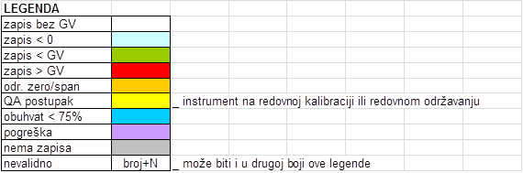
12.3 VALIDATION OF MEASUREMENT DATA
European Union IPA 2013 Programme for Croatia
Validity status marking of the measurement results
Marking the validity status of the measurement data must be clearly and unambiguously. Only valid results are included in the calculation of the data coverage.
For example:
Energy Research and Environmental Protection Institute

Slide 33
12.3 VALIDATION OF MEASUREMENT DATA
European Union IPA 2013 Programme for Croatia
Only valid results are included in the calculation of the data coverage.
For example:
Continuous measurement 1 g = 365x24 = 8760 hours
Within this 167 hours QA / QC is not included
Valid hourly concentrations - 8515
MinVremPok = 8760-167 / 8670 = 8593/8760 = 0.981
Data coverage = Nvalid / NMinVremPok = Nvalid / (Ngod * MinVremPok%)
Data coverage = 8515 / N_{MinVremPok} = 8515 / (8760 * 0,981)= 8515/ 8593 = 0,9908 = 99,1%
Energy Research and Environmental Protection Institute

Slide 34
12.4 MEARGING DATA CRITERIA AND THE CALCULATION OF STATISTICAL PARAMETERS
European Union IPA 2013 Programme for Croatia
Criteria used for validation when collecting data and calculating statistical parameters in relation to the limits with regard to the protection of human health:
Parametar | Required ratio of valid data
hourly values | 75% (i.e. 45 minutes)
eight-hourly values | 75% of the value (i.e. six hours)
highest daily eighth-hourly value | 75% consecutive eight-hour moving average calculated on the basis of hourly information (i.e. 18 eight-hour average on day)
daily values | 75% of the hourly average (i.e. at least 18-hour values)
average annual value | 90% (1) hourly values or (if it is not available) the daily value during the year
The requirements for the calculation of annual averages do not include data loss due to regular calibration or regular maintenance of measuring instruments.
Energy Research and Environmental Protection Institute

Slide 35
12.4 MEARGING DATA CRITERIA AND THE CALCULATION OF STATISTICAL PARAMETERS
European Union IPA 2013 Programme for Croatia
The criteria used to validate the collection of data and calculation of statistical parameters from the target value and the long-term goal of ozone
Parametar | Required ratio of valid data
hourly values | 75% (tj. 45 minuta)
eight-hourly values | 75% of the value (i.e. six hours)
highest daily eighth-hourly value | 75% eight-hour moving average (i.e. 18 eight-hour day on average)
AOT40 | 90% of the hourly values over a certain period to calculate AOT40 value (1)
average annual value | 75% of summertime values (April to September), and 75% in the winter period (January to March, October to December), separately
number of exceedances and maximum monthly value | 90% of the highest daily osmotic averages (27 available daily values per month) 90% of the hourly value, measured between 8.00 and 20.00 on Central European Time
number of exceedances and maximum annual values | five out of six months during the summer period (April to September)
Energy Research and Environmental Protection Institute

Slide 36
12.4 MEARGING DATA CRITERIA AND THE CALCULATION OF STATISTICAL PARAMETERS
European Union IPA 2013 Programme for Croatia
AOT40 - parameter indicating the sum of the difference between one - hour concentrations of ozone higher than 80 μg / m3 and 80 μg / m3 during a given period (from May 1th to July 31th each year for the protection of vegetation, and from April 1th to September 30th for the protection of forests), taking into account only one-hour values measured every day between 8:00 and 20:00 on Central European Time. (accumulated exposure over a threshold of 40 ppb)
¹In cases where all possible measured data are not available, the following factor is used to calculate the AOT40 value:
AOT40 (estimate) = AOT40 (measured) x total number of hours (*) / number of measured one-hour values
(*) This is the number of hours within the definition period for AOT40 (ie from 08:00 to 20:00 on Central European Time).
Energy Research and Environmental Protection Institute

Slide 37
12.4 MEARGING DATA CRITERIA AND THE CALCULATION OF STATISTICAL PARAMETERS
European Union IPA 2013 Programme for Croatia
Calculated statistical parameters - for each pollutant the same statistical parameters are not counted
data coverage - for relevant time of averaging,
arithmetic mean (mean annual value, winter mean),
median (50 percentile),
the relevant percentile (for each pollutant, depending on the average time, a specific percentile is to be calculated)
maximum value,
the number of limit or target value exceedances
the number of warning thresholds and / or notification thresholds exceedances
the number of upper and lower estimation thresholds exceedances
Energy Research and Environmental Protection Institute

Slide 38
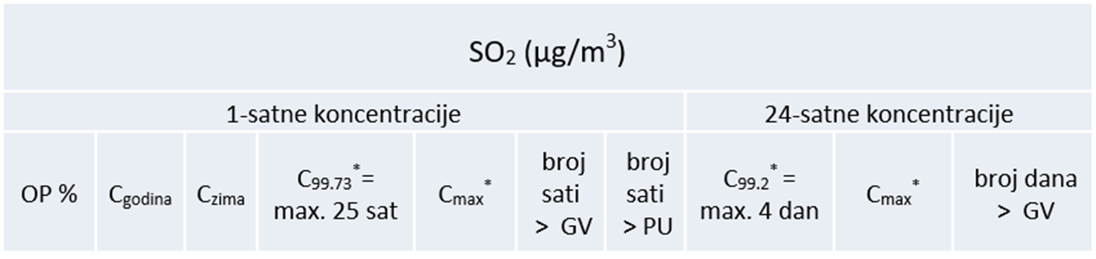
12.4 MEARGING DATA CRITERIA AND THE CALCULATION OF STATISTICAL PARAMETERS
European Union IPA 2013 Programme for Croatia
Statistical parameters being calculated - for each pollutant the same statistical parameters are not counted
Pollutants due to the protection of human health
Statistical parameters: SO₂
* Indicates the statistical parameter being calculated, but no assessment of the pollution is compared to that parameter
Energy Research and Environmental Protection Institute

Slide 39
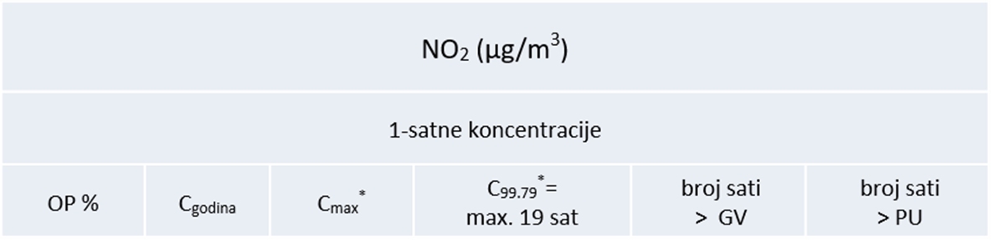
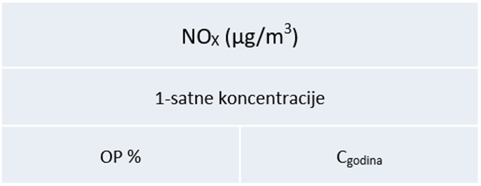
12.4 MEARGING DATA CRITERIA AND THE CALCULATION OF STATISTICAL PARAMETERS
European Union IPA 2013 Programme for Croatia
Statistical parameters: NO₂ i NOx
* Indicates the statistical parameter being calculated, but no assessment of the pollution is compared to that parameter
Energy Research and Environmental Protection Institute

Slide 40
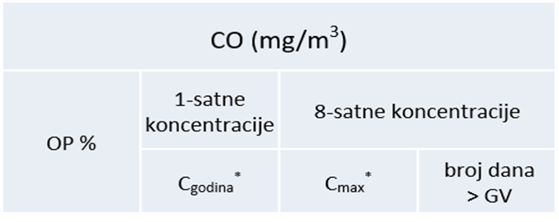
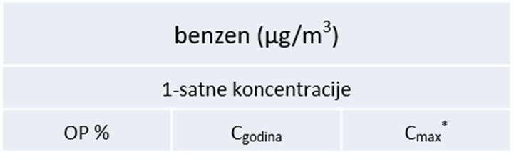
12.4 MEARGING DATA CRITERIA AND THE CALCULATION OF STATISTICAL PARAMETERS
European Union IPA 2013 Programme for Croatia
Statistical parameters: CO i benzene
* Indicates the statistical parameter being calculated, but no assessment of the pollution is compared to that parameter
Energy Research and Environmental Protection Institute

Slide 41
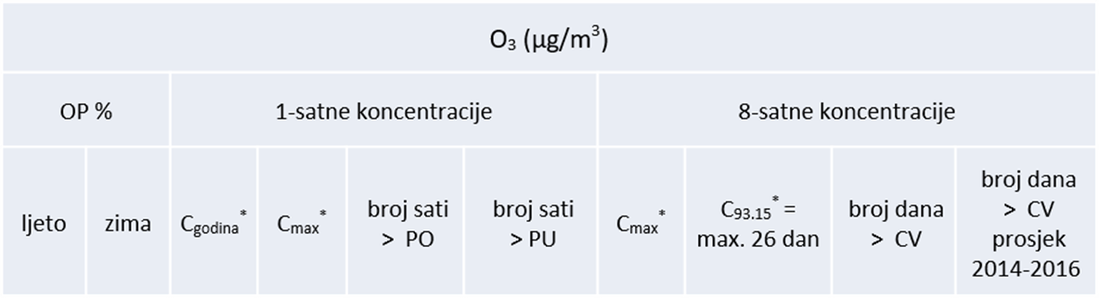
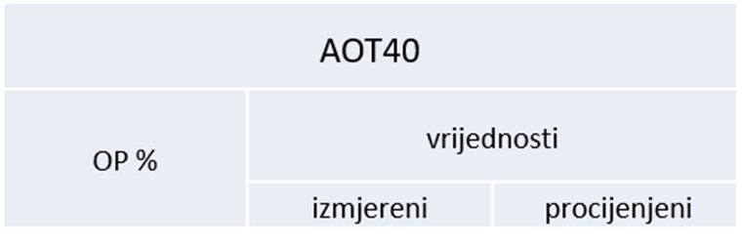
12.4 MEARGING DATA CRITERIA AND THE CALCULATION OF STATISTICAL PARAMETERS
European Union IPA 2013 Programme for Croatia
Statistical parameters: ozone i AOT40
* Indicates the statistical parameter being calculated, but no assessment of the pollution is compared to that parameter
Energy Research and Environmental Protection Institute

Slide 42
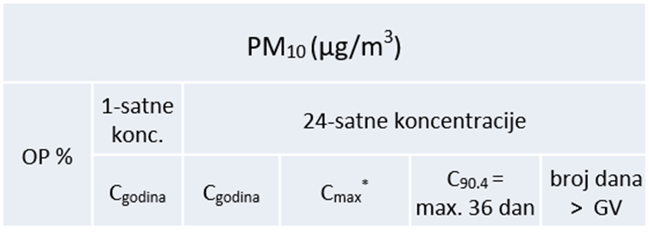
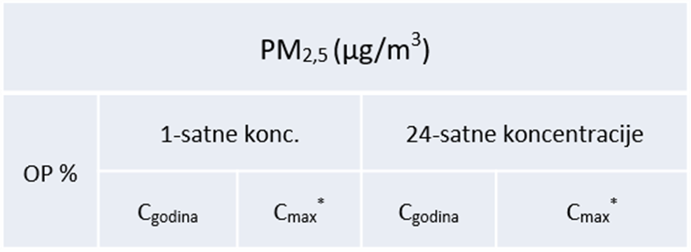
12.4 MEARGING DATA CRITERIA AND THE CALCULATION OF STATISTICAL PARAMETERS
European Union IPA 2013 Programme for Croatia
Statistical parameters:: PM₁₀ i PM_{2,5}
* Indicates the statistical parameter being calculated, but no assessment of the pollution is compared to that parameter
Energy Research and Environmental Protection Institute

Slide 43
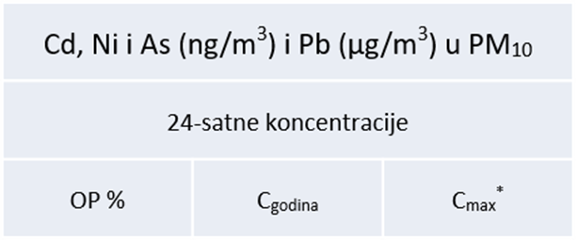
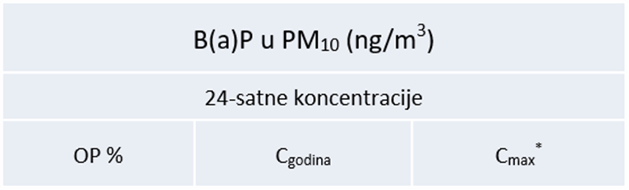
12.4 MEARGING DATA CRITERIA AND THE CALCULATION OF STATISTICAL PARAMETERS
European Union IPA 2013 Programme for Croatia
Statistical parameters:: metals and B(a)P u PM₁₀
* Indicates the statistical parameter being calculated, but no assessment of the pollution is compared to that parameter
Energy Research and Environmental Protection Institute

Slide 44
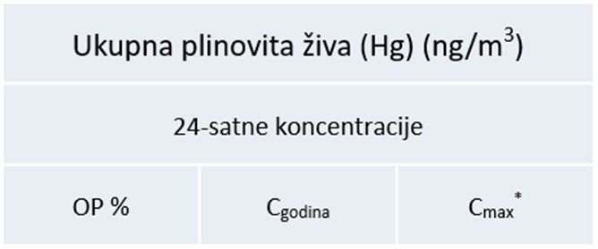
12.4 MEARGING DATA CRITERIA AND THE CALCULATION OF STATISTICAL PARAMETERS
European Union IPA 2013 Programme for Croatia
Statistical parameters:: Total gaseous mercury Hg₀
* Indicates the statistical parameter being calculated, but no assessment of the pollution is compared to that parameter
Energy Research and Environmental Protection Institute

Slide 45
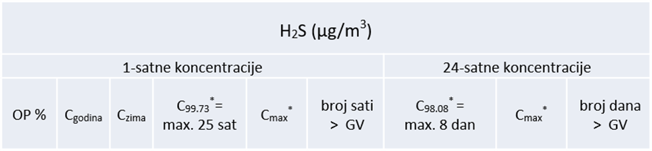
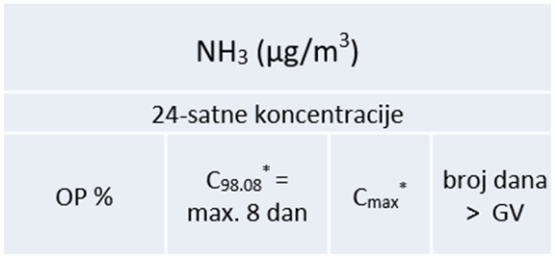
12.4 MEARGING DATA CRITERIA AND THE CALCULATION OF STATISTICAL PARAMETERS
European Union IPA 2013 Programme for Croatia
Pollutants due to the quality of life
Statistical parameters:: H₂S i NH₃
* Indicates the statistical parameter being calculated, but no assessment of the pollution is compared to that parameter
Energy Research and Environmental Protection Institute

Slide 46
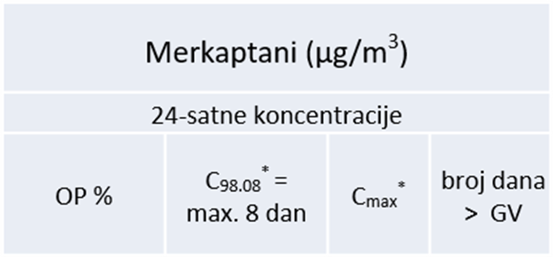
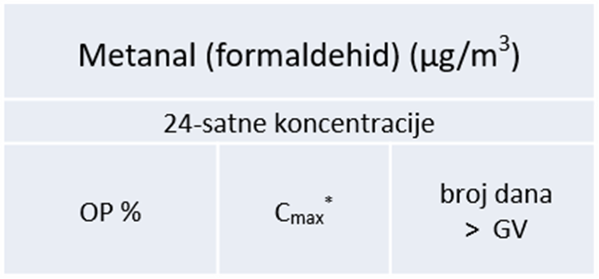
12.4 MEARGING DATA CRITERIA AND THE CALCULATION OF STATISTICAL PARAMETERS
European Union IPA 2013 Programme for Croatia
Statistical parameters:: mercaptans and methanal (formaldehyde)
* Indicates the statistical parameter being calculated, but no assessment of the pollution is compared to that parameter
Energy Research and Environmental Protection Institute

Slide 47
THANK YOU FOR YOUR ATTENTION
Energy Research and Environmental Protection Institute
Disclaimer: The contents of this publication are the sole responsibility of EKONERG – Energy Research and Environmental Protection Institute, Ltd. and can in no way be taken to reflect the views of the European Union
This project is funded by the European Union

